Slide 1
Highways Safety Hub
Blue Star award ideas
This presentation includes a selection of innovative ideas / suggestions for improvement

Slide 2
Blue Star awards presentation - Part 5
Training

Slide 3
Index listing of Blue Star awards (page 1 of 5)
B000 - Plant person interface, good practice
B001 – Diphoterine
B002 - Traffic management
B003 – Health Wellbeing (Champion)
B004 – Work on bridge deck / Wind monitoring system
B005 – Safetime scaffold tags
B006 – BIM
B007 – RAG batter
B008 – Water mist fire extinguisher
B009 – Smart screens
B010 – Mission Room
B011 – Controlling permits to work
B012 – WAH / Load and unload vehicles
B013 – Gridforce 30
B014 – Dumper camera
B015 – Excavator stickers
B016 – Chapter 8 chevrons
B017 – Occupational health (3 year plan)
B018 – TM airlock
B019 – Health, safety, wellbeing strategy
B020 – Training

Slide 4
Index listing of Blue Star awards (page 2 of 5)
B021 – Readi-guard (RO) TM airlock gates
B022 – Bunkabin accommodation
B023 – Competence
B024 – Technology to improve safety (BIM)
B025 – Red Zone training
B026 – Public route planning
B027 – Safety pegs to maintain TBS zone
B028 – Control of vehicles leaving site
B029 – Vehicle payload and weights sheet
B030 – Message boot laces
B031 – Google maps S&O planning
B032 – LGV enforcement
B033 – HAVwear watches
B034 – LED lights on goal posts
B035 – Briefing document (daily)
B036 – Call button for ped access to site
B037 – QR codes and NFC readers
B038 – Skipper tape exclusion zone
B039 – Value engineering
B040 – Improving communication

Slide 5
Index listing of Blue Star awards (page 3 of 5)
B041 – Incident investigation
B042 – TM (influencing drivers / body cams)
B043 – PatrolLive
B044 – Work behind access and exit points
B045 – Control of HAVS (PAM breaker)
B046 – Safety gates
B047 – Works access gate (WAG)
B048 – Site security)
B049 – A duplication of BS Award 43
B050 – A duplication of BS Award 44
B051 – Animated RAMS
B052 – Yellow mat
B053 – SMART SITE monitors
B054 – Vest and helmet lights
B055 – TM works order management system
B056 – TM nightshift isolation plan
B057 – Service avoidance
B058 – 2-way radios, key info, dumper cam
B059 – Use of stop gates
B060 – Plant person interface training

Slide 6
Index listing of Blue Star awards (page 4 of 5)
B061 – Induction training area 1
B062 – PPI, JCB Hydradig, Prolec restrictors
B063 – LifeVac
B064 – Virtual reality (VR) training
B065 – Rotating dumper cab
B066 – Surface mining (use of Power Plane)
B067 – Occupational health, fatigue
B068 – Service avoidance
B069 – Overhead protection
B070 – Banners (bridge name / No / location)
B071 – Remote drilling (No HAVS)
B072 – MEWP virtual reality training simulator
B073 – Drone tech aerial mapping stockpiles
B074 – Halo Deployment ‘Worker Guardian’
B075 – Base Light 420x portable lighting
B076 – Virtual reality PPI training
B077 – Hi-vis dumper
B078 – Milwaukee 6232 Band saw
B079 – GTL gas to liquids fuel
B080 – VMS overhead protection

Slide 7
Index listing of Blue Star awards (page 5 of 5)
B081 – VMS TM exit
B082 – Trimble site vision
B083 – Survey giraffe
B084 – Public pedestrian safety
B085 – Emergency call button
B086 – V2 VDZ System
Blue Star awards, issued by calendar year:
2015 – 11no.
2016 – 44no. (+2no. Duplicates)
2017 – 12no.
2018 – 11no.
2019 – 2no.
2020 – 3no.
2021 –
Total = 83no.

Slide 8
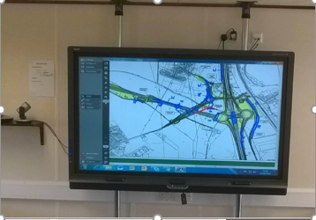
B009 – Smart screens
Smart screens:
Of size 70" interactive fitted with HD Camera + microphone to enable conferencing and briefings have been installed at both compounds.
They have Skype for Business to allow video calls and presentations, can be used as a flip chart saving on paper, and used as a visualisation for works to be carried out.
Refer to doc for further details.

Slide 9
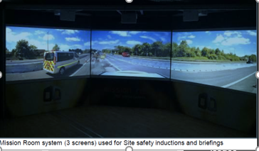
B010 – Mission Room
Mission Room:
Immersive technology based induction –
The 3-screen projector with surround sound has been used to improve the quality and effectiveness of site safety induction presentations
It better captures the audience’s attention and increases their level of absorption of the key safety issues

Slide 10
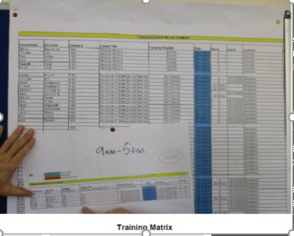
B020 – Training
Training –
Workforce competency is checked at the Induction stage / during the induction process.
A Training Matrix has been developed to allow for a skills gap analysis;
This feeds into the project training plan which details training courses, dates and delegates and is on display.

Slide 11
B023 – Competence
Competence:
Formal H&S qualifications of site based staff.
Interserve has adopted in full the Construction Skills ‘site safety Plus’ approach to the initial H&S training of site staff.
The approach uses level 1, 2 (Site supervisors safety training scheme) and 3 (Site managers safety training scheme, SMSTS).
This site currently has 100% compliance.
No photo available

Slide 12
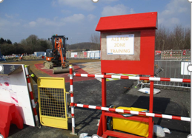
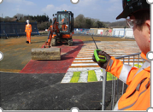
B025 – Red Zone training
Good work on PPI.
At induction, Red Zone training area set up, use of videos and models to demonstrate zones.
Boards showing plant and vehicle movements, footpaths and pedestrian walkways in place, control of pedestrians where large plant is operating, gate access controlled by vehicle marshals
Visits to CAT and JCB factories.
Red Zone training area in main compound
Red Zone training demonstrating button to stop plant

Slide 13
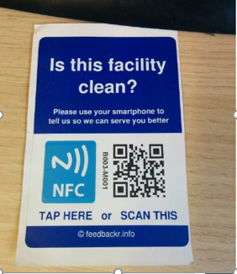
B037 – QR codes and NFC readers
QR codes and NFC readers:
Integrated into the daily processes by Site Management team.
QR codes are used on visible site documentation such as –
CPH&S plans
1st Aid posters
Routes to Hospital A&E
Quick reference of important info
Verification of CSCS cards on site.
App can be downloaded onto all smartphones.

Slide 14
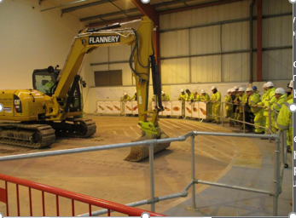
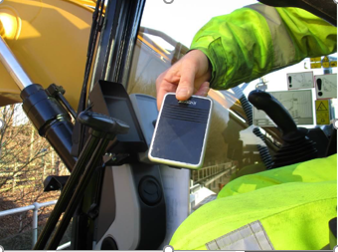
B060 – PPI training
Blue star awarded for proactive approach to PPI, including:
Training conducted by works manager
Bell push button for ganger to speak with plant operator
Dumper permit (to use)
Project light vehicle reversing procedure, including use of a short video clip.

Slide 15
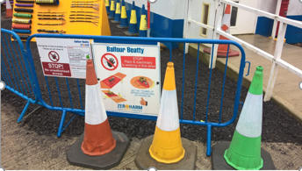
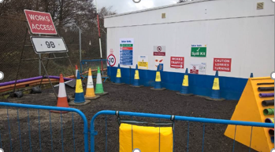
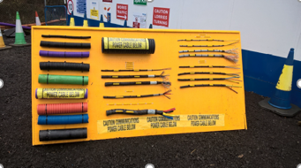
B061 – Induction training area 1
Induction introduced by a member of the Senior Management Team
Test at the end of induction, to ensure key points have been understood.
An area set up outside in the compound is to show and explain various initiatives including coloured road cones, goalposts, safety stations, spill kits, work access signage, and stop gates.

Slide 16
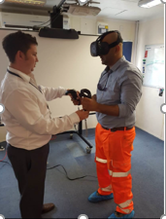
B064 – Virtual Reality Training
The site is developing Virtual Reality training for Plant Person Interface training.
It fully immerses the individual into a virtual environment that they can walk around, and if they walk too close to a machine, an alarm and a flashing light goes off to notify them that they are too close.

Slide 17
B064 – Virtual Reality Training
The site has already used 360° cameras to improve workforce awareness of what it is like to be on site adj. to significant activities, such as bridge lifts, and to give operatives an awareness of what plant operators can see from inside the cab.
No photo available

Slide 18
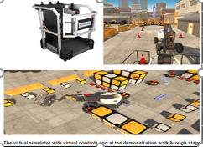
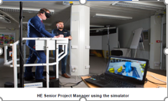
B072 – MEWP virtual reality training simulator
MEWP virtual reality training simulator:
Introduction of ground-breaking virtual reality simulators are designed to allow operators a true-to-life look and feel of operating an access platform in a safe and controlled environment.
The Simulator realistically simulates the sensation of boom and scissor operations.

Slide 19
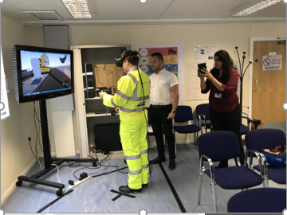
B076 – Virtual Reality PPI training
Virtual reality PPI training:
Places a person virtually into a construction scenario where an excavator is digging into the embankment and filling up a nearby wagon
The goal is to highlight red and amber danger zones around the plant, never pass behind the excavator and to reinforce gaining permission from the plant driver to pass by.

